Slide 1
Trends of cross-covariance, connections with discrete time nonlinear observability
Background Information:
https://pmc.ncbi.nlm.nih.gov/articles/PMC8511787/pdf/rspa.2021.0097.pdf
HAVOK - forcing linear model on a nonlinear system - does linear model retain enough information for state reconstruction?
https://grizzle.robotics.umich.edu/files/MoraalGrizzle1995TAC.pdf
https://en.wikipedia.org/wiki/Stein%27s_lemma
Stein’s Lemma - formula for the covariance of one random variable with the value of a function of another, two random variables are jointly normally distributed
The statistical correlation matrix Cov(g(x), x) = average Jacobian smoothed out over a Gaussian distribution
  *If a random vector is jointly Gaussian, then zero covariance implies independence
  Jacobian: local/deterministic test, differential notion of observability
  Covariance: global/statistical test, detects linear dependence, can fail due to symmetry.

Slide 2
For each case: X = [y, z] ~ N (0, [[ 𝝈_{1,}², 0], [ 0, 𝝈_{2,}² ]])
*variables are independent, E[y], E[z] = 0, multivariate Gaussian variables
Derive statistical correlation C, the cross-covariance matrix:
C = [[cov(g_{1,} y) , cov(g_{1,} z)]
[cov(g_{2,} y) , cov(g_{2,} z)]]
Verify with Stein’s Lemma:
*proved same in all cases
C = E[g(x)x^{T}]
Jacobian:
Dg = [[∂g_{1,}/∂y , ∂g_{1,}/∂z ]
[∂g_{2,}/∂y , ∂g_{2,}/∂z ]]

Slide 3
Case 1: Observable - Full Rank
g(x) = [y+ z², z]
C = [[cov(y+ z², y) , cov(y+ z², z)]
[cov(z, y) , cov(z, z)]]
= [[𝝈_{1,}², 0]
[0 , 𝝈_{2,}²]]
* exactly the original covariance matrix
Dg = [[∂(y+ z²)/∂y , ∂(y+ z²)/∂z ]
[∂z/∂y , ∂z,/∂z ]]
= [[1, 2z]
[0 ,1]]
det(Dg) = 1
For all points*
Full rank - no singularities

Slide 4
Case 2a: Weakly Observable
g(x) = [y, z²]
C = [[cov(y, y) , cov(y, z)]
[cov(z², y) , cov(z², z)]]
= [[𝝈_{1,}², 0]
[0 , 0]]
Dg = [[∂y/∂y , ∂y/∂z ]
[∂z²/∂y , ∂z²,/∂z ]]
= [[1, 0]
[0 , 2z]]
det(Dg) = 2z
det(Dg) = 0 at z =0

Slide 5
Case 2b: Weakly Observable
g(x) = [y, z³]
C = [[cov(y, y) , cov(y, z)]
[cov(z³, y) , cov(z³, z)]]
= [[𝝈_{1,}², 0]
[0 , 3𝝈_{2,}⁴]]
* Cov(X,X³)=E[X⁴]-E[X]E[X³]) = E[X⁴] = 3𝝈₂⁴
Dg = [[∂y/∂y , ∂y/∂z ]
[∂z³/∂y , ∂z³,/∂z ]]
= [[1, 0]
[0, 3z²]]
det(Dg) = 3z²
det(Dg) = 0 at z =0

Slide 6
Case 3: Not observable
g(x) = [y, y³]
C = [[cov(y, y) , cov(y, z)]
[cov(y³, y) , cov(y³, z)]]
= [[𝝈_{1,}², 0]
[3𝝈_{1,}⁴ , 0]]
Dg = [[∂y/∂y , ∂y/∂z ]
[∂y³,/∂y , ∂y³,/∂z ]]
= [[1, 0]
[3y²,0]]
det(Dg) = 0
For all points

Slide 7
import numpy as np
import matplotlib.pyplot as plt
# derived on paper
def C_case1(s1, s2):
return np.array([[s1**2, 0],
[0, s2**2]])
def C_case2a(s1, s2):
# g = (y, z^2)
return np.array([[s1**2, 0],
[0, 0]])
def C_case2b(s1, s2):
# g = (y, z^3)
return np.array([[s1**2, 0],
[0, 3*s2**4]])
def C_case3(s1, s2):
# g = (y, y^3)
return np.array([[s1**2, 0],
[3*s1**4, 0]])
cases = {
"Case 1 (observable):": C_case1,
"Case 2a (weakly observable):": C_case2a,
"Case 2b (weakly observable):": C_case2b,
"Case 3 (not observable):": C_case3,
}
Fix one standard deviation, sweep the other and assess singular values for each case
# vary the variance and loop
s1_fixed = 1.0
sigma2 = np.linspace(0.05, 3.0, 200)
fig, axes = plt.subplots(2, 2, figsize=(11, 8))
axes = axes.ravel()
for ax, (name, Cfun) in zip(axes, cases.items()):
sv_max, sv_min, cond = [], [], []
for s2 in sigma2:
C = Cfun(s1_fixed, s2)
svals = np.linalg.svd(C, compute_uv=False)
sv_max.append(svals[0])
sv_min.append(svals[-1])
ax.plot(sigma2, sv_max, label=r"$\sigma_{\max}(C)$")
ax.plot(sigma2, sv_min, label=r"$\sigma_{\min}(C)$")
ax.set_title(name, fontsize=9)
ax.set_xlabel(r"$\sigma_2$")
ax.set_ylabel("singular value")
ax.legend(fontsize=8)
ax.grid(alpha=0.3)
plt.tight_layout()
plt.savefig("cross-covariance.png", dpi=150, bbox_inches="tight")
plt.show()

Slide 8
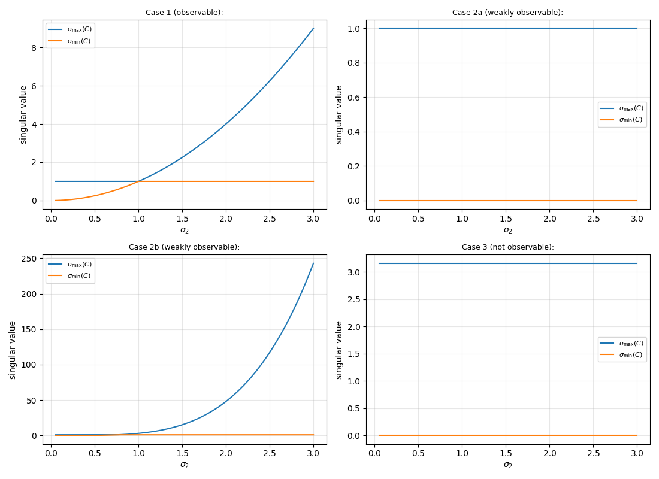
Blue line is the maximum singular value as the variance changes, orange line is the minimum singular value

Slide 9
Conclusions
When C is full rank and the Jacobian determinant ≠ 0:
  Perturbations to the state in every direction produce a detectable (linearly independent) change in the output at that point
  SVD of C gives you a statistical version of the rank condition
  Singular value going to 0: direction along which the output is (on average) statistically insensitive to a perturbing x - an unobservable direction.
When C is not full rank and the Jacobian ≠ 0:
  System is weakly observable - Gaussian-averaged correlation matrix reports rank deficiency anyway
  Fails to detect observability that genuinely exists, because the correlation is a global average, and the averaging washes out information the pointwise Jacobian still carries
  When Jacobian does = 0: system is locally unobservable at that specific state - pointwise condition
When C is not full rank and the Jacobian always = 0:
  Unobservability: the Jacobian is singular everywhere, not just at an isolated point
  Both the deterministic and statistical tests correctly flag this as unobservable

Slide 10
4. Cross-covariance only measures linear association so information is lost when g(x)x^{T} is an odd power
  In Case 2b, cov(z³, z) = E[z⁴] = 3𝝈_{2,}⁴. Because this moment is an even power, the association is “picked up” by the covariance matrix
  In Case 2a, cov(z²,z) = E[z³] = 0, since this is an odd moment under a symmetric Gaussian. This leads the matrix to have deficient rank and information about the z variable is lost
  Exposes the limitation of linear-correlation-based observability testing: whether a moment is odd/asymmetric vs. even/symmetric determines whether cross-covariance will correctly flag a weakly-observable case
5. Relationship between minimum singular value and system observability
σmin⁡(C) flat at zero across all variances (Cases 2a, 3) is a structural unobservability
Shrinking to zero - well-conditioned system becoming ill-conditioned
Tracking how σmin⁡(C) varies with the input variance:
  Value that stays at zero regardless of variance signals a variance-independent loss of information
  σmin⁡(C) only approaches zero as the Gaussian variance approaches zero (Case 1): loss of rank is caused by insufficient data variation, not by a loss of observability

Slide 11
σ min⁡(C) correctly detects unobservability (Case 3) and reflects singularities as observable (Case 2b), but it can produce false negatives when the nonlinearity has an odd-order derivative structure that cancels under a symmetric input distribution (Case 2a).
This is the limitation of linear correlation that motivates a shift to distance correlation, which is sensitive to global, nonlinear dependence and does not suffer from even/odd moment cancellation.
Discrete-time analog of stacking Lie derivatives - Replace linear cross-covariance with distance-correlation on a time delay embedding
Partial distance correlation to determine whether successive delay coordinates contribute new observability information.

